Slide 1
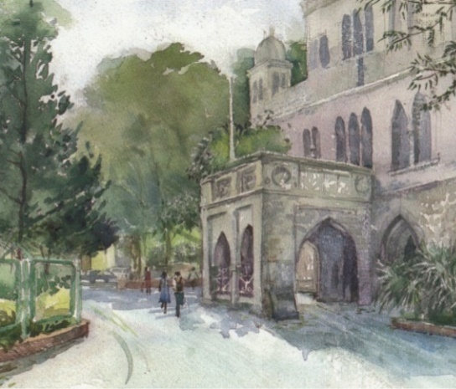

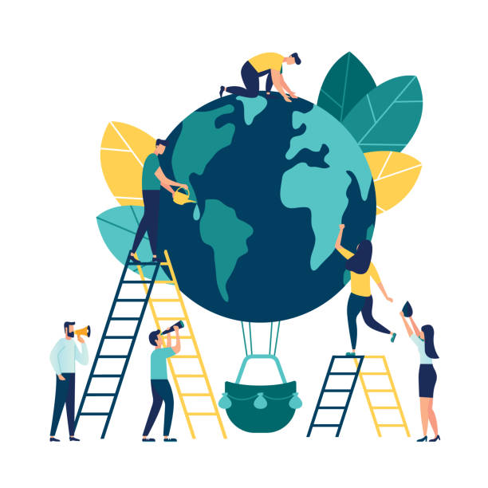
Biology for Engineers (BFE)
NEP Complied Syllabus
Crosstalk of Biology and Engineering
----------------------------------------------
UNIT 1
a) Biologically inspired technologies: Case studies of designs in nature and inspired technologies, Biomemetics: Nature inspired material and mechanisms, Self-healing Bioconcrete, Biomining, Algorithms in nature
b) Contribution of engineering in biological domain: Contribution of Microscope, Imaging techniques, Bio-medical Instruments, Mechanisms (Ergonomics)

Slide 2
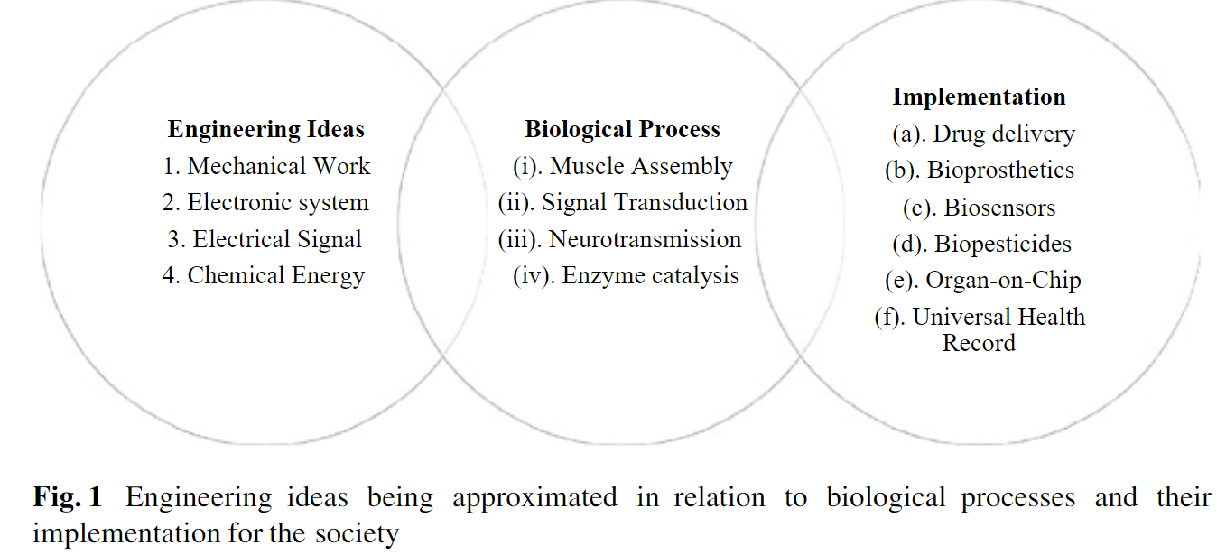

Slide 3
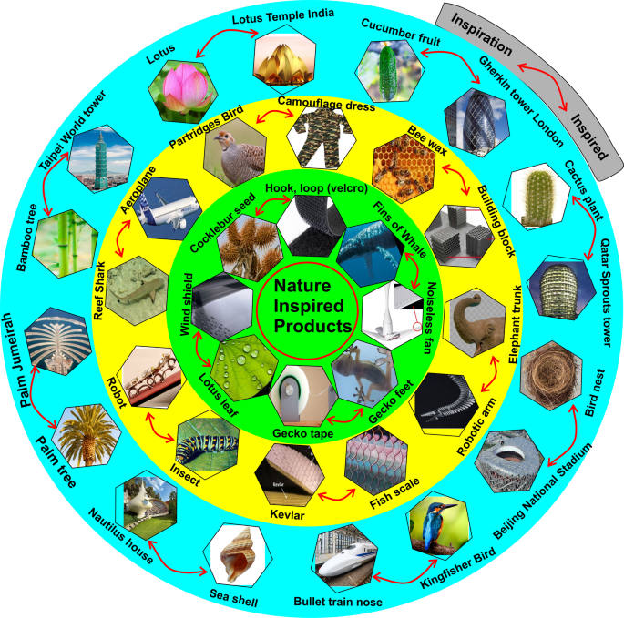
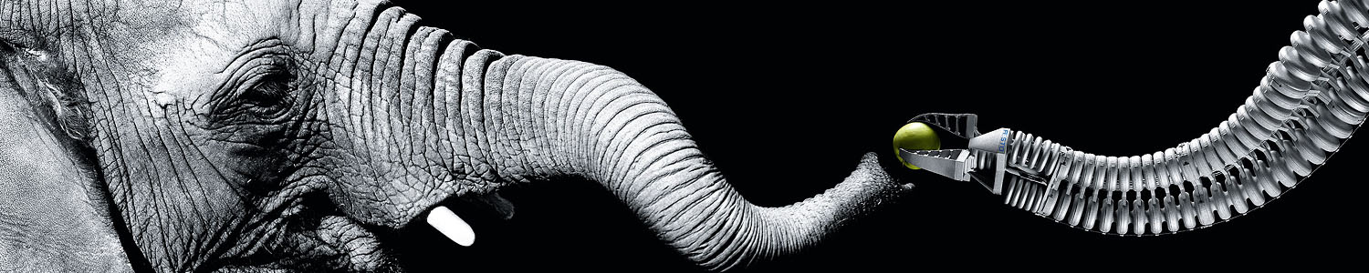
Nature Inspired Technologies

Slide 4
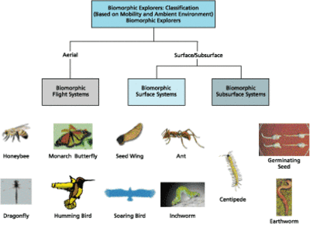

Slide 5
Biomimicry engineering is the practice of creating designs based on structures and sequences from the Earth's natural world, including its plants, animals and geographies. These designs allow engineers and other professionals to create sustainable infrastructure and equipment for everyday activities and habitation processes, like public transportation and water sanitation. The engineers involved in these types of projects often collaborate with biologists. Biologists identify natural processes that are efficient and sustainable, then engineers implement these processes into building or tool designs.
Improving performance through studying natural processes
Reducing costs by using energy and resources more efficiently
Creating opportunities for collaboration between STEM professionals
Providing solutions to common needs by developing innovative designs
Enhancing an organization's brand using environmentally conscious practices

Slide 6
Biomimicry Engineer
Perfusionist
Equipment technician
Microbiologist
Pharmaceutical Manufacturer
Biomedical Engineer
Architect
50 Examples of Biomimicry:
https://www.learnbiomimicry.com/blog/best-biomimicry-examples

Slide 7
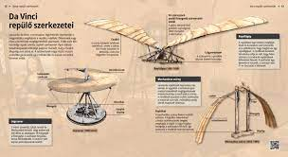
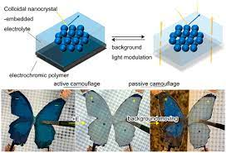
Leonardo da Vinci’s Flying Machine – 1485
Well over 500 years ago, Leonardo da Vinci was developing plans for a flying machine. With nothing remotely similar in circulation, his inspiration had to come from the world around him. Mimicking the shapes of bird and bat wings, he was able to design a concept that, while ineffective, would inspire others for hundreds of years to come.
Camouflage – 1890
Sir Edward Poulton, a British zoologist and early adopter of Darwinism, believed that animals mimicked their environments for safety and proposed this as proof for natural selection. In his 1890 publication, The Colours of Animals, he describes this theory and suggests how humans could harness this same technology. While camouflage has changed and improved over the years, most of its many interpretations have been borrowed from nature.

Slide 8
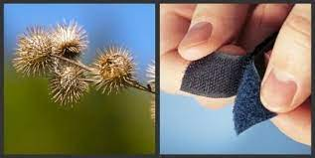
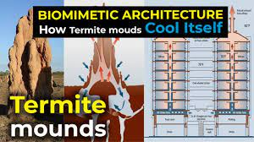
Velcro – 1941
George de Mestral, a Swiss engineer, turned an inconvenience into an opportunity while out on a hunting trip in the early 1940s. While walking through the hills, he noticed cocklebur seed capsules sticking to his clothing as he walked past. After closer inspection of the burs and their hooks, he developed and patented the hook-and-loop design currently known as Velcro.
“Passive” Air Conditioning – 1996
Operational for over 20 years now, the Eastgate Complex in Harare, Zimbabwe has been a leader in building cooling technology since it’s conception. Designed after a termite mound, the building using “passive cooling” technology to consume 90% less energy than modern air conditioning. Further research has shown that other models may be even more effective and prototypes are currently being designed.

Slide 9
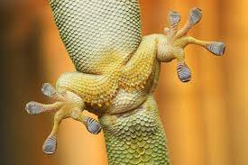
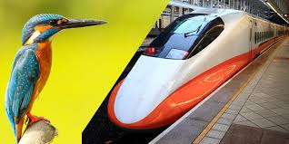
Medical Staples – 2014
A current leader in many different biomimicry technologies, the Karp lab has drawn inspiration from porcupine needles in their design for a more secure medical staple. Sutures closing dangerous wounds need to be as sturdy as possible. By mimicking the unidirectional barbs found in porcupine quills, the Karp lab has created a design that will hold in soft tissue far more effectively than other staples have before.
Japanese Bullet Trains – 2016
The Hokkaido Shinkansen, the latest iteration of Japan’s famous bullet trains, is based on the face and beak of the King Fischer bird. These trains are known to reach speeds in excess of 300 km/h and have an impressive track record boasting 0 fatalities in their greater than 50-year history.

Slide 10
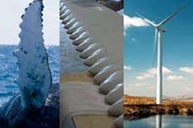
Whale Fin Wind Turbines – 2018
For the past 10 years, Whalepower Corporation has been doing research, starting in a Harvard lab and growing into a company, to revolutionize wind power. Drawing inspiration from bumps on the leading edge of humpback whale fins, the engineers at Whalepower have designed turbine blades that channel air around artificial tubercles. This maximizes the blades ability to operate in low/infrequent wind, while maintaining their ability to function in high wind as well.
The ridges on the front fins of a humpback whale, called tubercles, influence how water flows over the fins. The tubercules allow them to swim at high speeds despite their great size. Engineering and science professionals often collaborate on projects involving whale tubercules to create improved machinery for travel or energy production. Scientists often measure these tubercles using a mathematical model, while engineering professionals use this data to create a 3D model and determine how a similar design might improve lift and reduce wind drag on a submarine, aircraft or turbine.

Slide 11
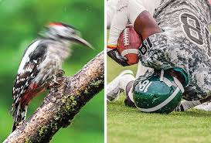
Woodpeckers use their long beaks to forage for insects and create homes in the trunks of trees without sustaining head injuries from the fast and forceful pecking Biologists conducted CT scans and reviewed recordings of the bird, finding structures in a woodpecker's body that work together to improve its shock absorption. Aerospace engineers often use these structures to design meteorite-resistant spacecraft and airplane black boxes that can absorb more force before malfunctioning. This natural design can also help aircraft and aeronautical engineers develop more quality technology in the future.
Swimsuits :
Lotus Effect (Water Repellence)
The surfaces of some aquatic animals, such as otters and seals, are water-repellent, reducing drag caused by water clinging to the body.
Application in Swimsuits:
Advanced swimsuits are designed with fabrics that repel water, reducing the drag caused by water absorption. This also helps keep the suit lightweight during races.
Woodpecker Football Helmets – 2018
When designing a new football helmet to help with chronic prevalence of CTE in the NFL, the team at VICIS turned to the humble woodpecker. These amazing birds spend a lot of time hitting their heads against hard objects, without any serious repercussions. After creating an impact absorption system mimicking the soft tissue surrounding the skull of the woodpecker, they are confident they have a product that will help decrease injury in athletes engaging in high-impact sport.

Slide 12
Hydrodynamic Green Energy Solutions – Currently in Development
Currently in late stage development, the bioWAVE aims to harness the fluid dynamic power of waves and convert it into electricity. Designed after coral, the structure is able to be pushed back and forth by shifting tides. This will have major advantages over other sources of green energy as it will provide more constant energy production than either wind or solar.
Biohacking Limb Regeneration Technology – Currently in Development
Researchers in labs around the world are pulling inspiration from an aquatic salamander, the axolotl, in designs for medical technologies to aid with regeneration of damaged or removed limbs. This create can regrow lost limbs over the course of a few weeks, complete with soft, cardiac, and neuronal tissue. By sequencing and searching the axolotl genome, scientists are learning how we may be able to use this technology for ourselves in the future.

Slide 13
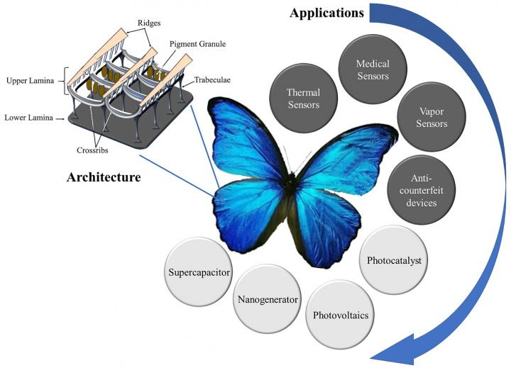
Natural biological systems are constantly developing efficient mechanisms to counter adverse effects of increasing human population and depleting energy resources.
Their intelligent mechanisms are characterized by the ability to detect changes in the environment, store and evaluate information, and respond to external stimuli.
Bio-inspired replication into man-made functional materials guarantees enhancement of characteristics and performance.
Specifically, butterfly architectures have inspired the fabrication of sensor and energy materials by replicating their unique micro/nanostructures, light-trapping mechanisms and selective responses to external stimuli.
These bio-inspired sensor and energy materials have shown improved performance in harnessing renewable energy, environmental remediation and health monitoring.
Therefore, this review highlights recent progress reported on the classification of butterfly wing scale architectures and explores several bio-inspired sensor and energy applications.

Slide 14
Sharks can reach fast speeds because of their scales' shape, which resemble tiny teeth that cut through water currents and lessen turbulence.
-- Scientists first created a paint that resembles shark skin to reduce how much friction ships produce on the water and how much fuel they use.
Since shark skin is also resistant to parasitic and bacterial growth, medical researchers applied a similar design to create a plastic film to cover hospital walls.
-- Both marine biologists and medical engineers may work on projects involving shark fins to improve the health and safety of providers and their patients.

Slide 15
Beetles native to the Namib Desert survive the dry environment by collecting water on their backs.
They aim their wings toward the ocean breeze and the bumps on their backs funnel water droplets toward their mouths.
Entomologists and engineers created a water bottle with similar water-collecting and water-repelling bumps.
This project could help with water preservation efforts and make water more easily accessible for communities in dry regions.
Professionals in conservation or community planning professions may participate in multiple water conservation projects that involve this biomimicry engineering method.

Slide 16
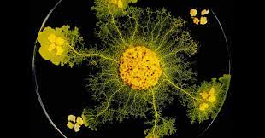
Slime mold is a single-celled organism that thrives in damp environments, like forest floors, and feeds on microbes by spreading its nutrient-carrying tubes out in all directions.
To conserve energy, it keeps only the tubes that find the most nutrients and leaves chemical trails to remember which areas don't have food.
Entomologists and railway engineers studied this mold to see how it could help improve transportation systems.
-- They placed the slime mold on a damp surface that represented a city and laid oat flakes in positions that represented the surrounding cities. When the slime mold expanded, it looked like a more efficient version of a railway system that didn't require a central control system.
Urban planners and transportation engineers may use this example and similar instances to improve city plans by studying natural designs.

Slide 17
Algae remove pollutants from water through a process called bio-utilization.
-- For example, algae covering coral reefs stimulates its growth by pulsing water over its surfaces, which enhances the coral's photosynthesis and prevents it from absorbing re-filtrated water.
Natural science professionals refined this process to purify water that has man-made contaminants in it, such as fertilizer runoff.
-- Professionals like extension agents and water treatment specialists may use this natural purification system to enhance their designs and processes.

Slide 18
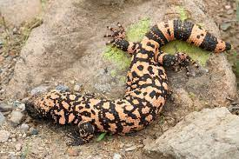
Herpetologists and pharmaceutical scientists studied Gila monsters to develop medicine for diabetes patients.
-- Their venom contains proteins that help cells release glucose, so researchers developed a synthetic form of the protein that reduced blood sugar levels in humans more efficiently and improved how the pancreas creates insulin.
By studying Gila monsters and animals with similar capabilities, medical engineers can develop new life-saving technology or enhance current practices.

Slide 19
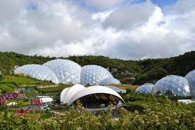
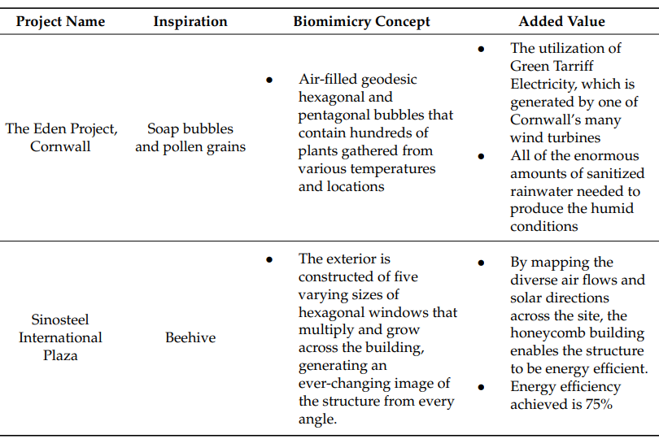
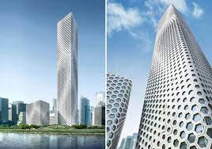

Slide 20
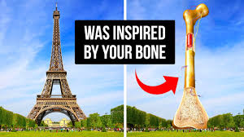
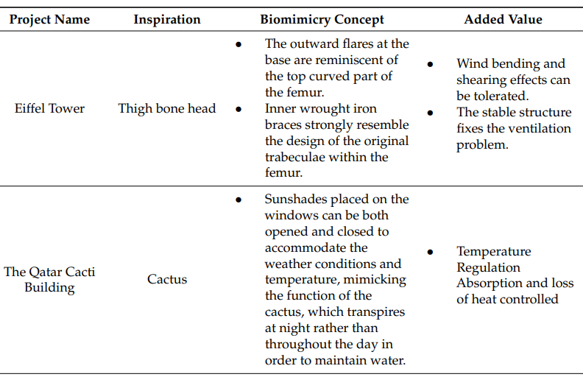
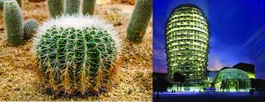

Slide 21
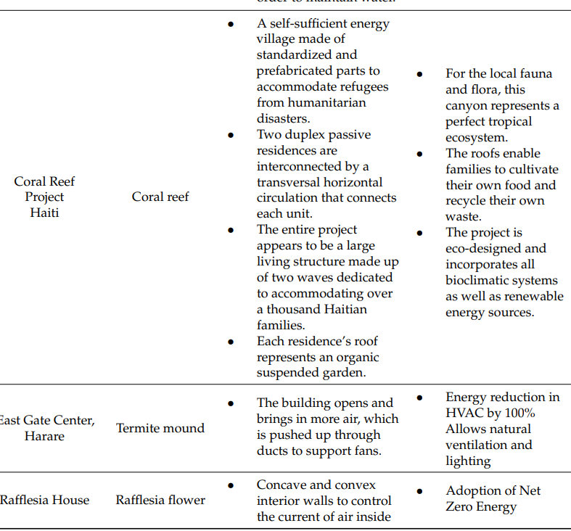
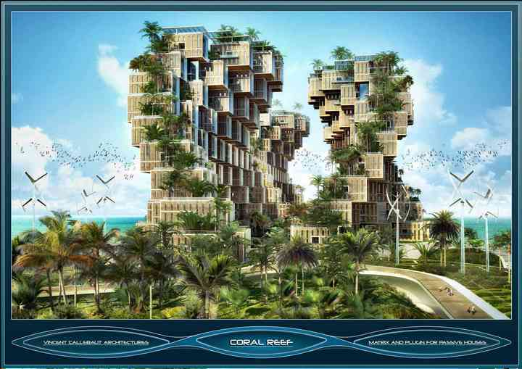
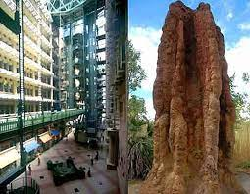
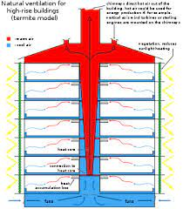
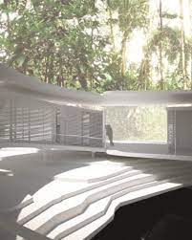

Slide 22
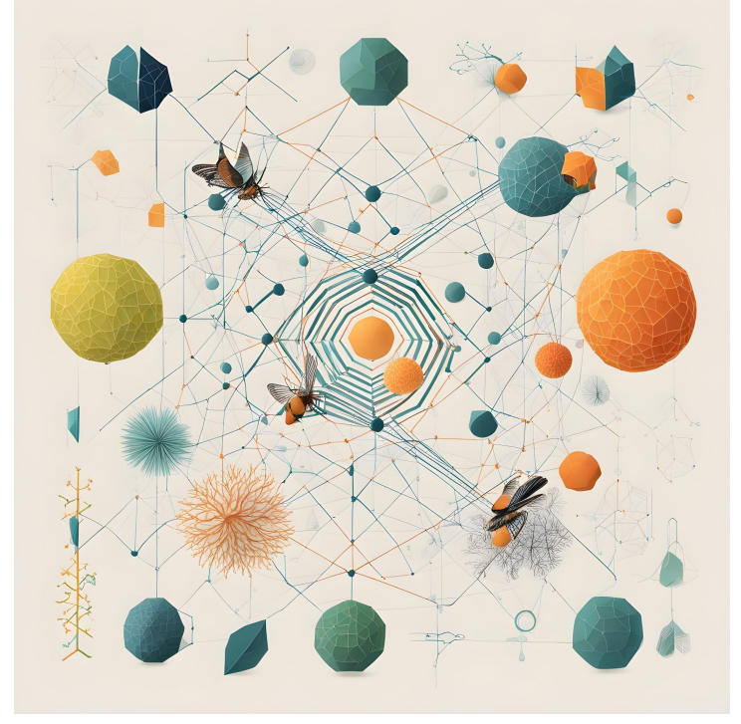
Biological Algorithms
Particle Swarm Optimization (PSO)
Genetic Bee Colony (GBC)
Fish Swarm Algorithm (FSA)
Cat Swarm Optimization (CSO)
Whale Optimization Algorithm (WOA)
Artificial Algae Algorithm (AAA)
Elephant Search Algorithm (ESA)
Cuckoo Search Optimization Algorithm (CSOA)
Moth flame optimization (MFO)
Grey Wolf Optimization (GWO)
Ant colony optimization (Dorigo 1992)
Ant-based routing

Slide 23
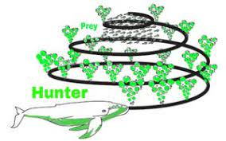
Whale Optimization Algorithm (WOA)
Mirjalili and Lewis in 2016
social behaviour of humpback whales
hunting strategy which is called bubble-net feeding

Slide 24
Contribution by the Engineers

Slide 25
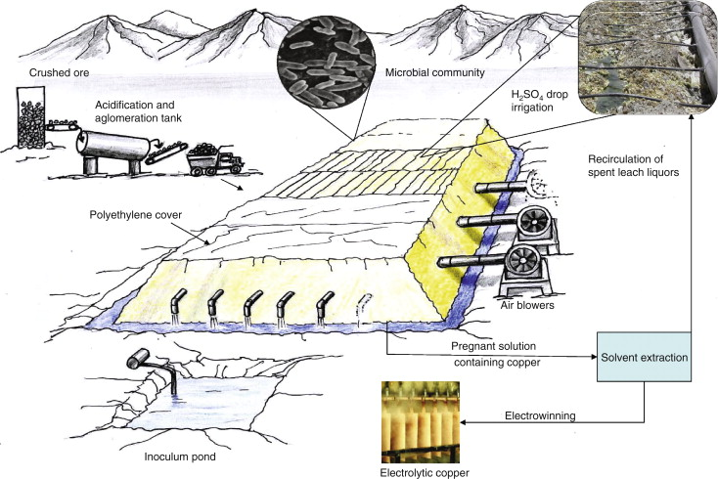
Biomining

Slide 26
Bioengineering
Bioengineering or Biomedical Engineering is a discipline that advances knowledge in engineering, biology, and medicine
molecular biology, biochemistry, microbiology
pharmacology
cytology
immunology and neuroscience
Biomedical engineering Biomedical technology
Biomedical Diagnosis Biomedical Therapy
Biomechanics Biomaterials.
Genetic engineering Cell engineering

Slide 27
Specialty areas
Biomechanics
Bioinstrumentation
System Physiology
Clinical Engineering
Rehabilitation Engineering

Slide 28
Recent advances …
Artificial joints
MRI
Heart pacemaker
Arthroscopy
Heart – Lung machine
Artificial skin / implant
Kidney dialysis
Angioplasty

